Slide 1
New England Housing Costs: Rent as a Share of Income
March 12, 2020
Authors:
Liz Stanton, PhD
Bryndis Woods
Eliandro Tavares
Applied Economics Clinic
www.aeclinic.org

Slide 2
Lower-income households bear a greater rent burden.
Poorer households spend more of their income on rent than richer households do
With few exceptions, 10% or less of New England’s richest ($100K+) households spend 40% or more of their income on rent
Across New England, around 60% of the lowest income (less than $10K) households spend 40% or more of their income on rent

Slide 3
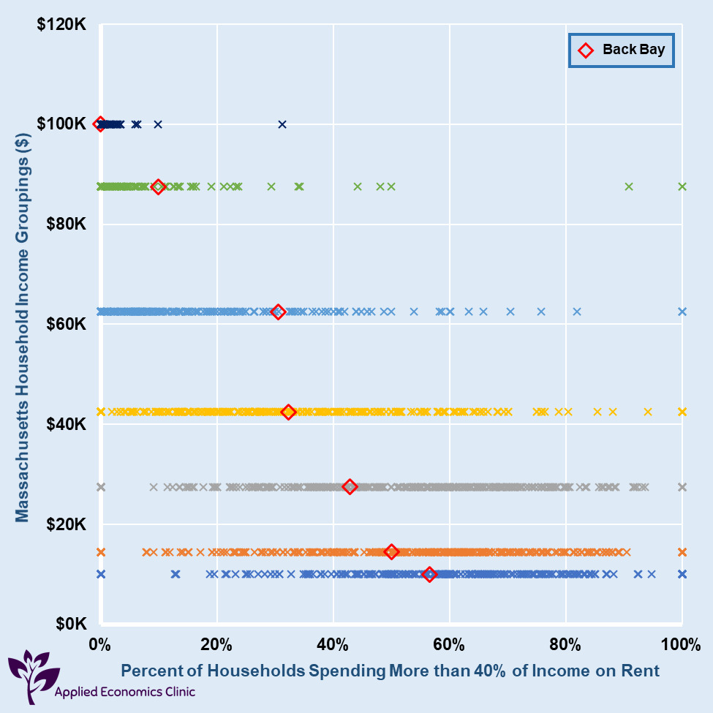
Poorer households spend more of their income on rent than richer households do.
We divided each town or neighborhood’s households into 7 income groups: each shown as an “X”. (Here, Back Bay is shown as a red diamond. )
1% of Back Bay’s $100K+ households spend 40% or more on rent
31% of Back Bay’s $35-$74K+ households spend 40% or more on rent
57% of Back Bay’s less than $10K+ households spend 40% or more on rent

Slide 4
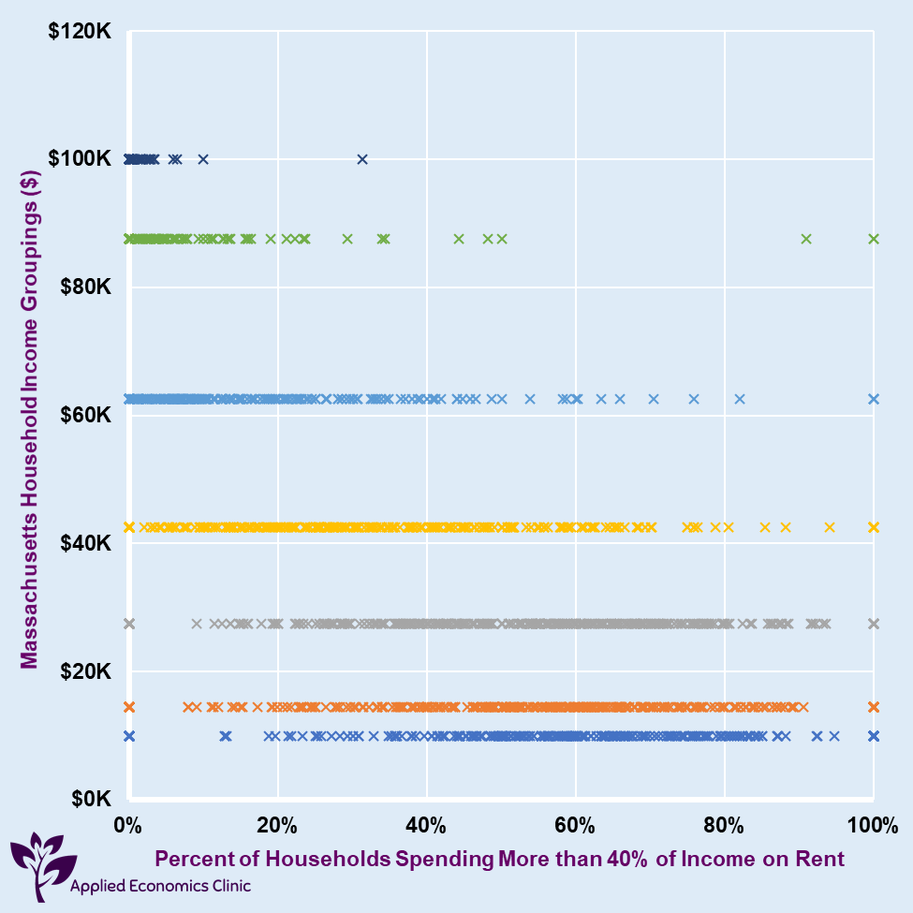
Massachusetts

Slide 5
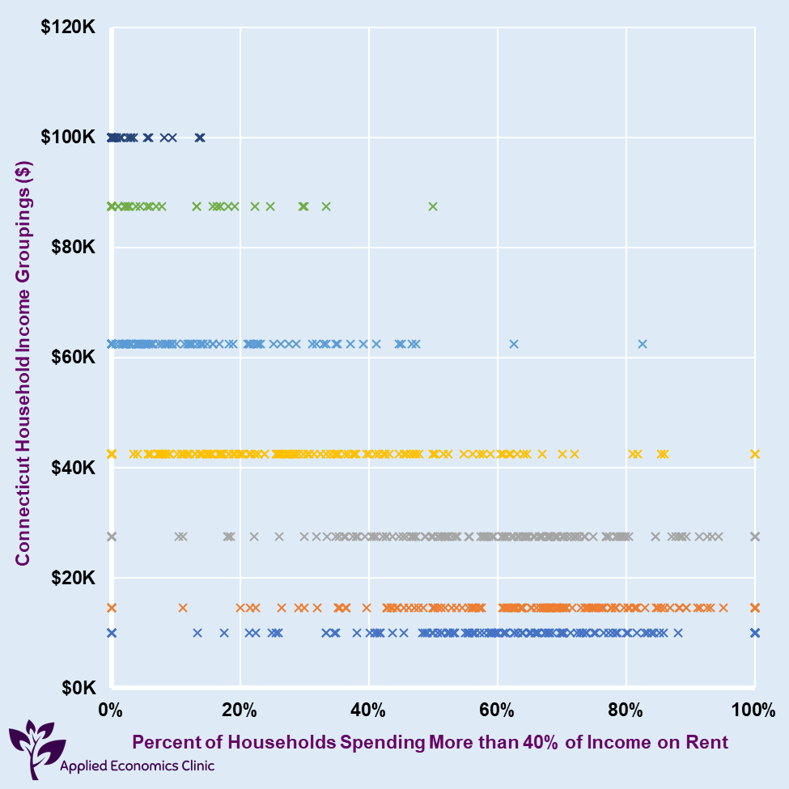
Connecticut

Slide 6
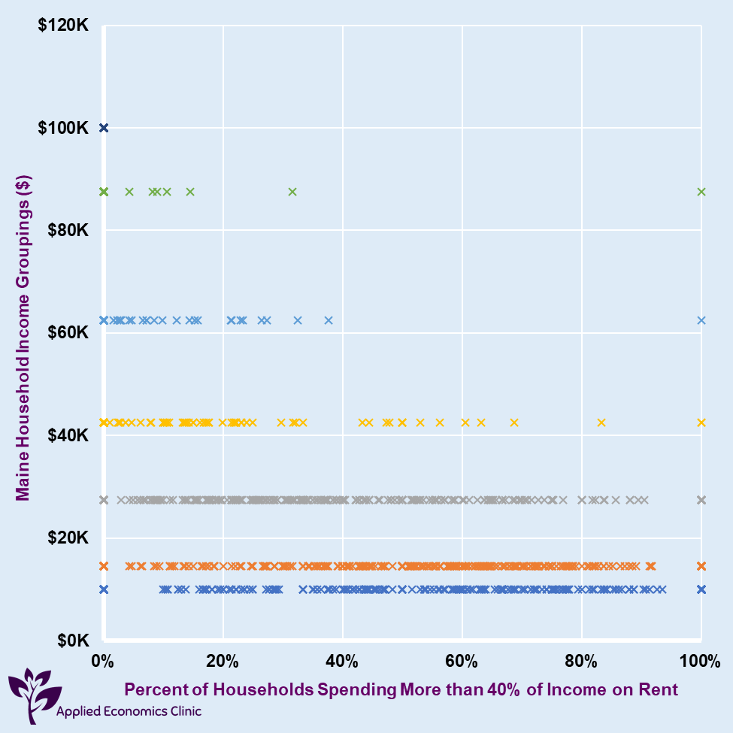
Maine

Slide 7
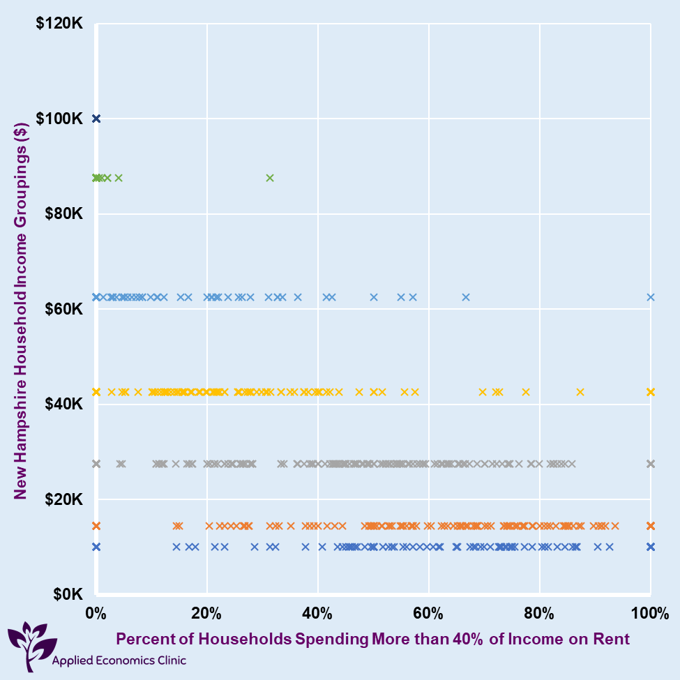
New Hampshire

Slide 8
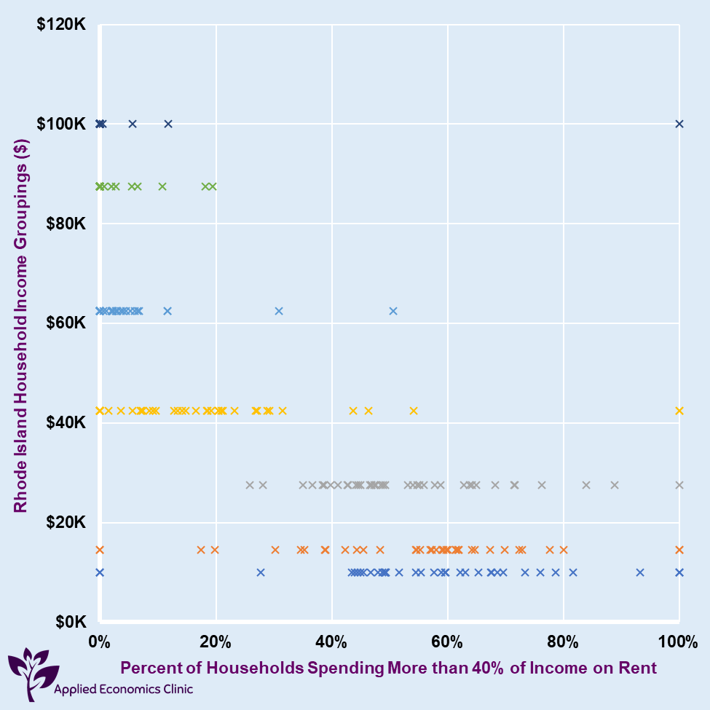
Rhode Island

Slide 9
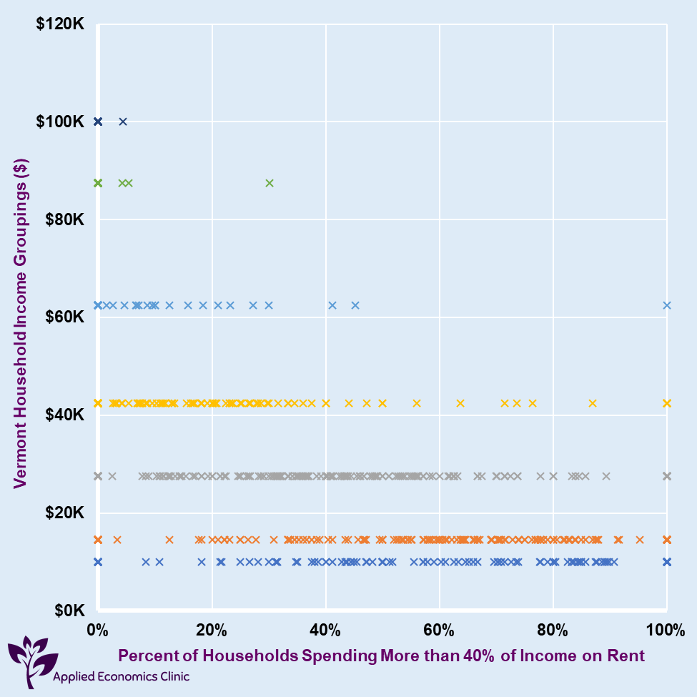
Vermont

Slide 10
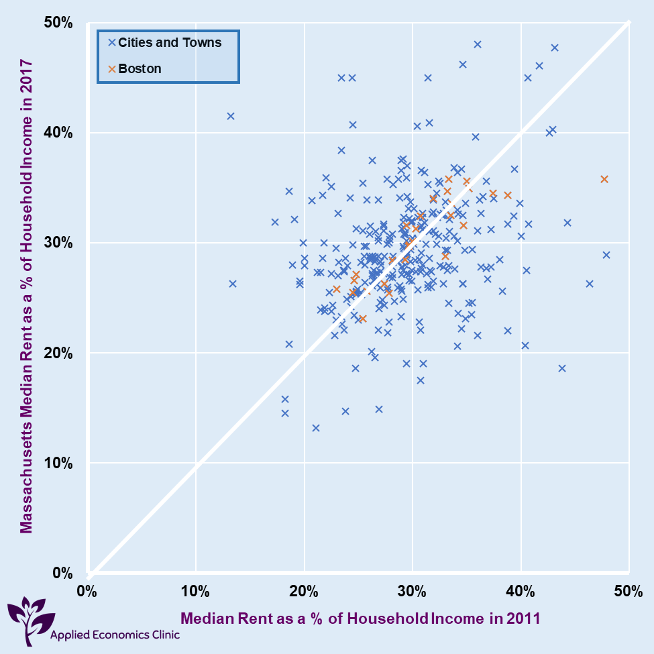
Some households’ rent as a share of income has been falling, others rising.
Each “X” shows a town or neighborhood
The vertical axis shows median rent as a share of income in 2017: These range from 12% to 50% in New England.
(The median means the household in the middle: half of all households pay more in rent as a share of income, half pay less).
The horizontal axis shows median rent as a share of income in 2011.
The closer the “X” to the white diagonal line, the less the median rent share changed from 2011 to 2017.

Slide 11
Some households’ rent as a share of income has been falling, others rising.
What raises your town’s median rent? (left/upper side of the white diagonal)
Bad outcomes: Incomes fall or rents grow for low income households
Displacement: High rents drive out lower income households
Condo-ization: More expensive housing becomes owned (instead of rented)

Slide 12
Some households’ rent as a share of income has been falling, others rising.
What lowers your town’s median rent? (right/lower side of the white diagonal)
Happy outcomes: Incomes grow or rents fall for low income households
Housing degradation: Quality of housing declines
Trickle-nowhere: Incomes grow or rents fall for high income households

Slide 13
Massachusetts

Slide 14
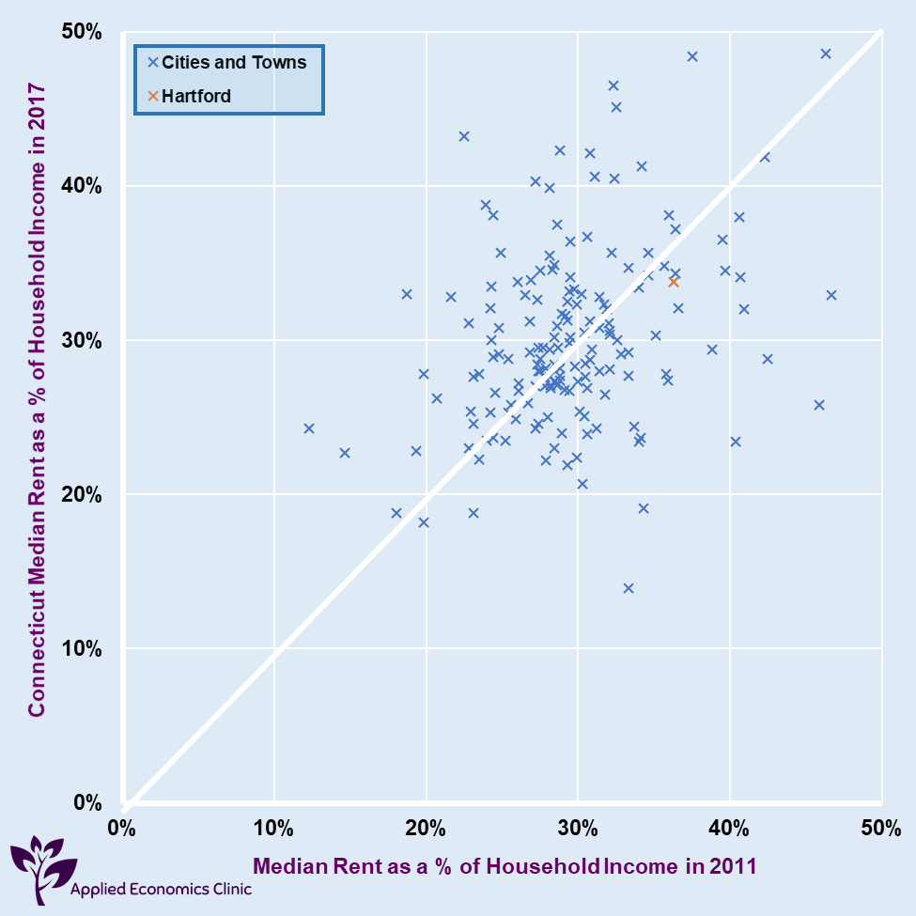
Connecticut

Slide 15
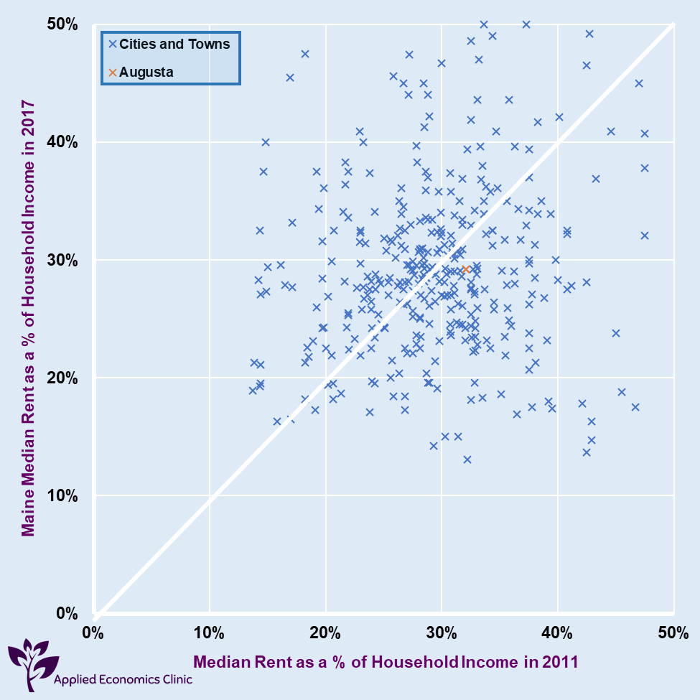
Maine

Slide 16
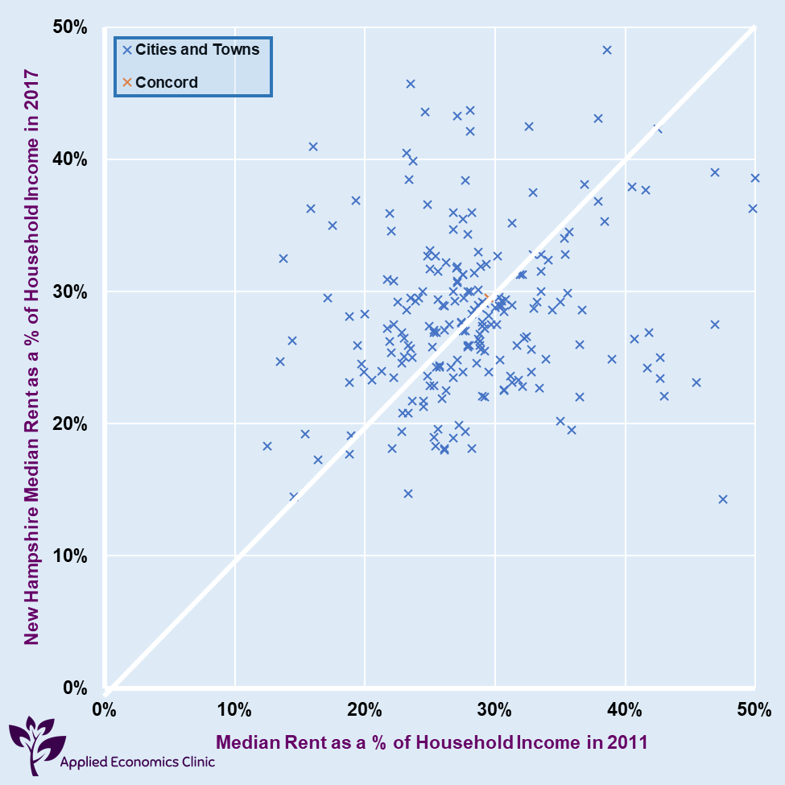
New Hampshire

Slide 17
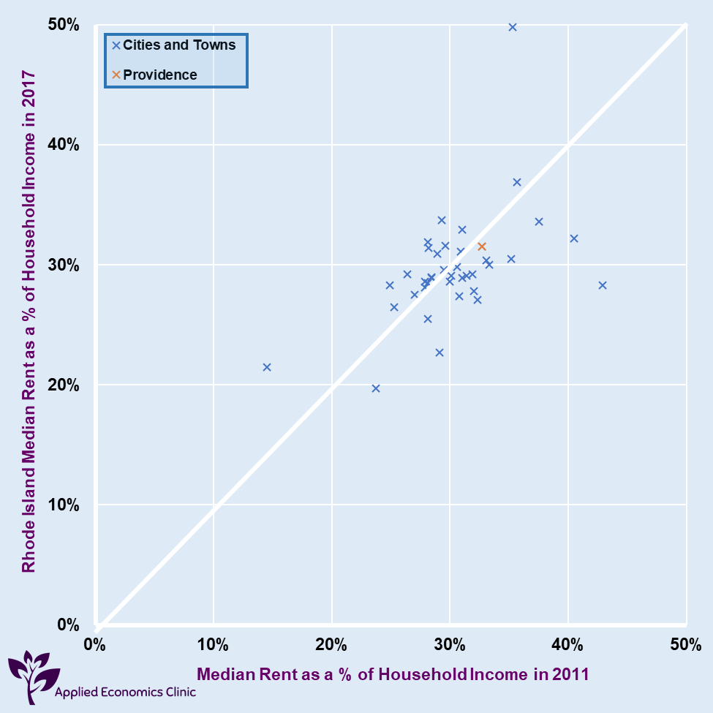
Rhode Island

Slide 18
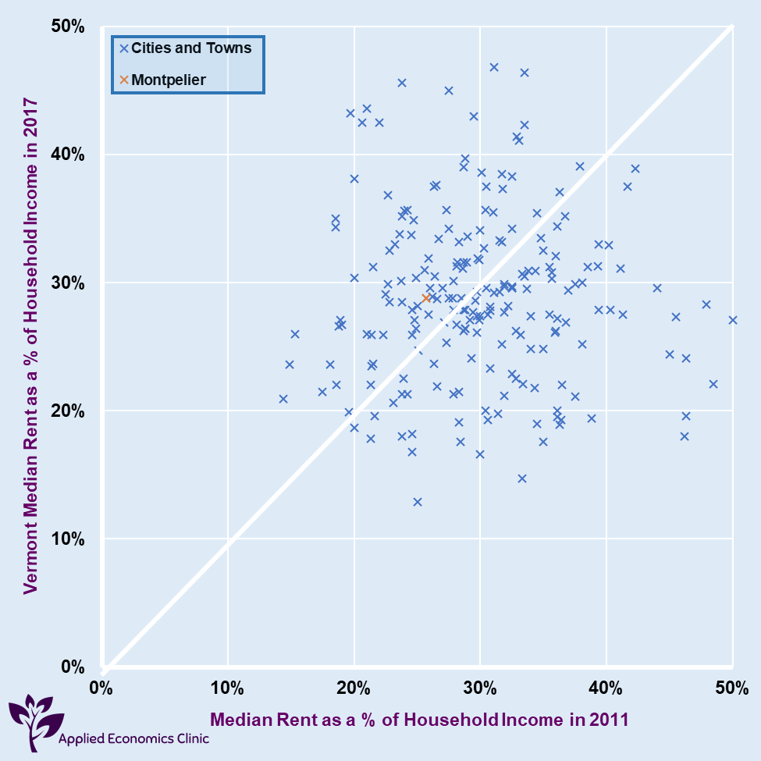
Vermont

Slide 19
Questions?
Contact: Bryndis Woods
bryndis.woods@aeclinic.org
www.aeclinic.org

