Slide 1
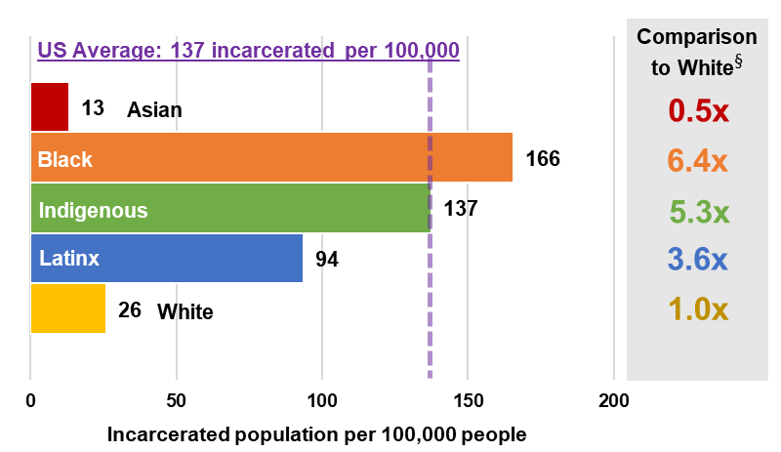
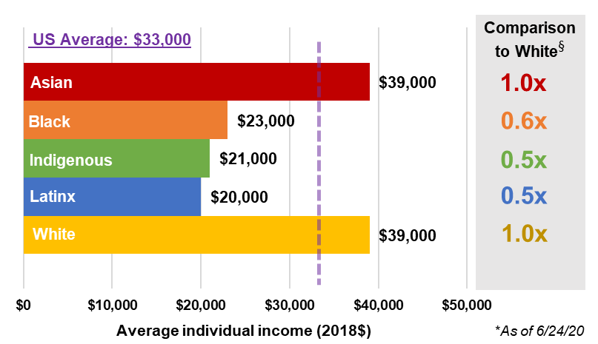
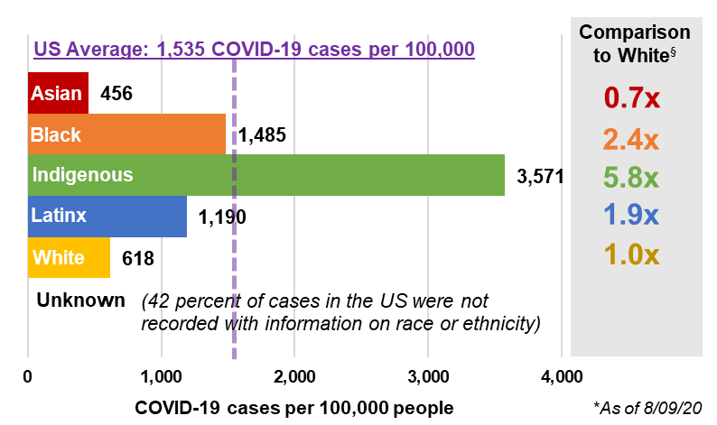
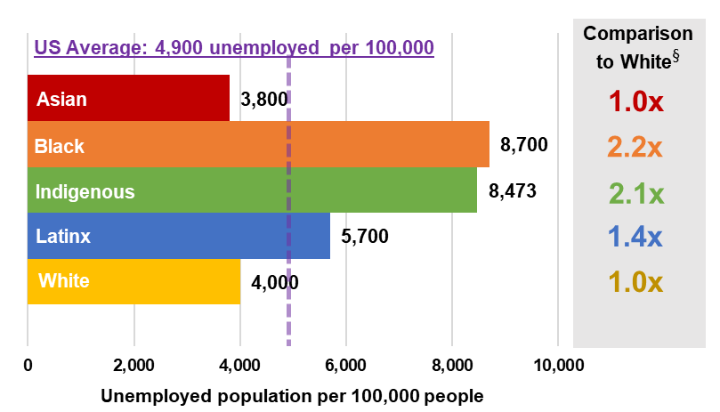
UNITED STATES
Incarceration
Average Income
COVID-19 Cases*
Unemployment
These values highlight the disparities between BIPOC (Black populations, Indigenous populations, and populations of color) and white populations. Today in the United States, Black persons have a COVID-19 positive rate 2.4 times that of white persons.
§

Slide 2
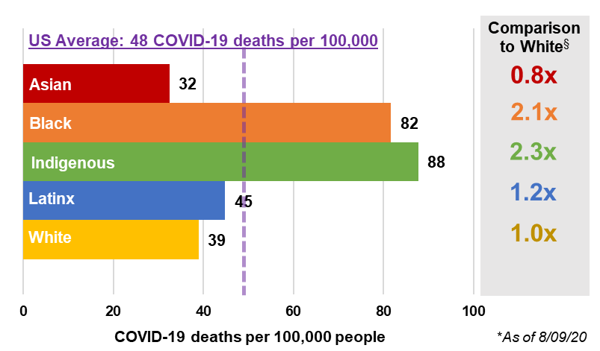
UNITED STATES
COVID-19 Cases*
COVID-19 Deaths*
These values highlight the disparities between BIPOC (Black populations, Indigenous populations, and populations of color) and white populations. Today in the United States, Black persons have a COVID-19 positive rate 2.4 times that of white persons.
§

Slide 3
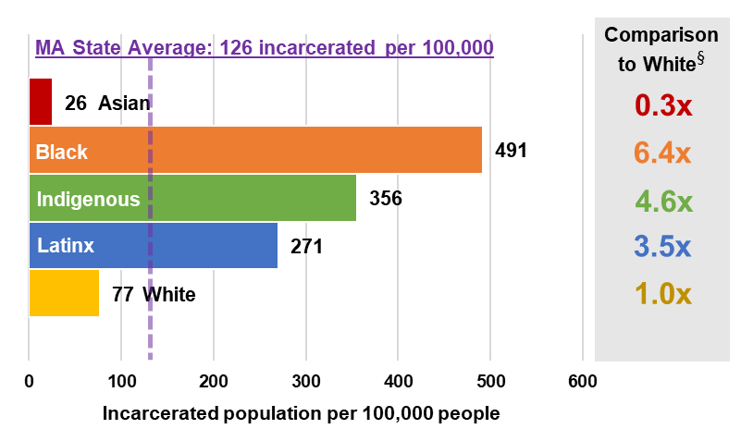
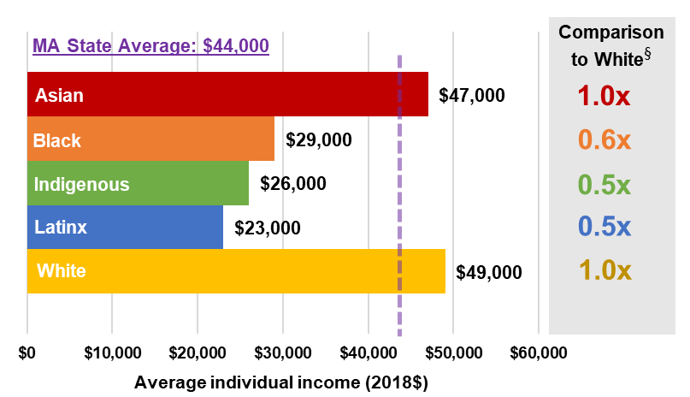
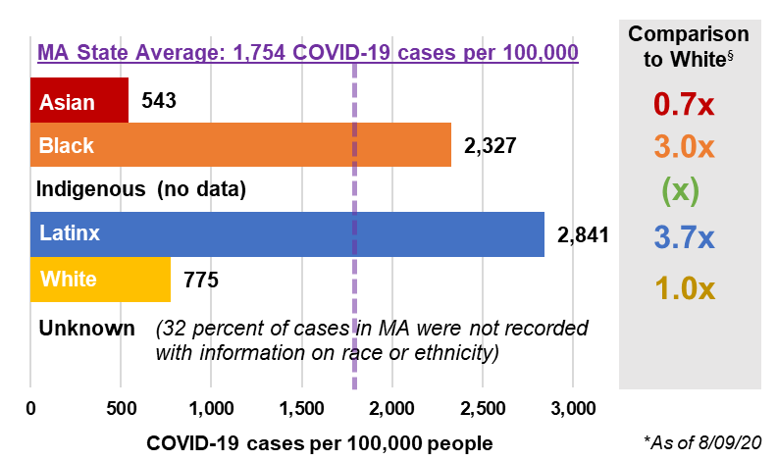
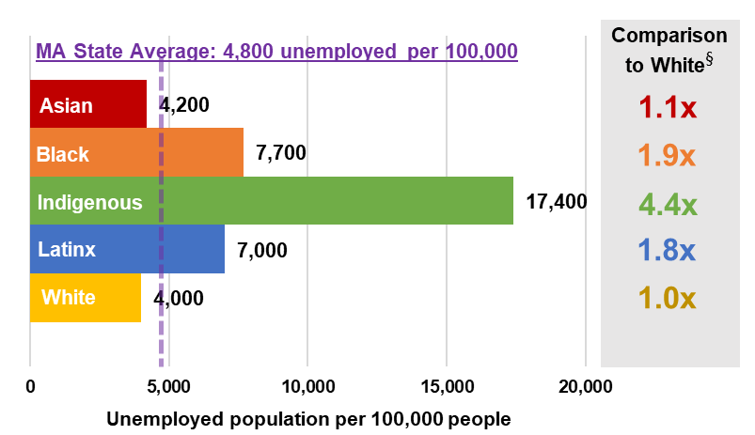
MASSACHUSETTS
Incarceration
Average Income
COVID-19 Cases*
Unemployment
These values highlight the disparities between BIPOC (Black populations, Indigenous populations, and populations of color) and white populations. Today in Massachusetts, Black persons have a COVID-19 positive rate 3.0 times that of white persons.
§

Slide 4
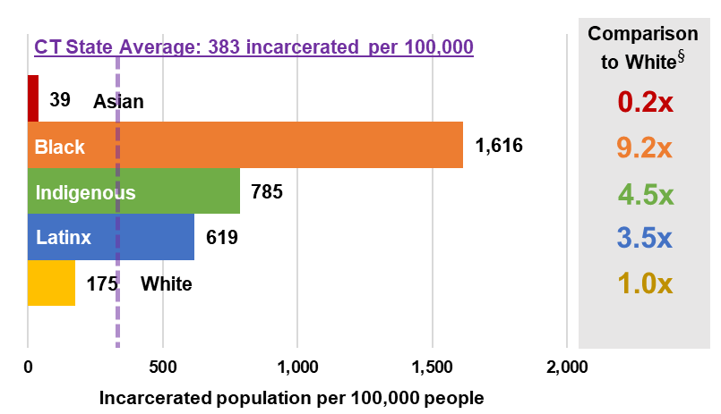
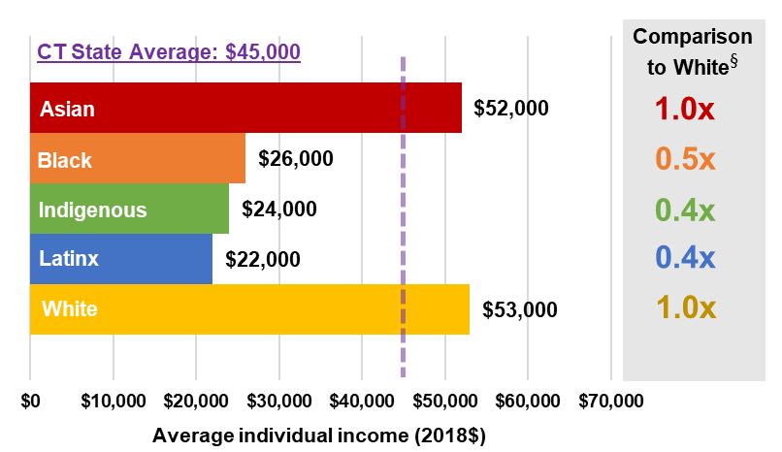
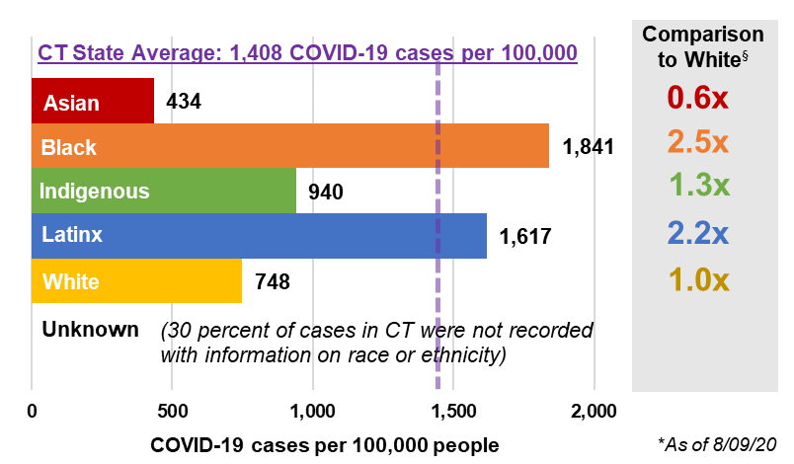
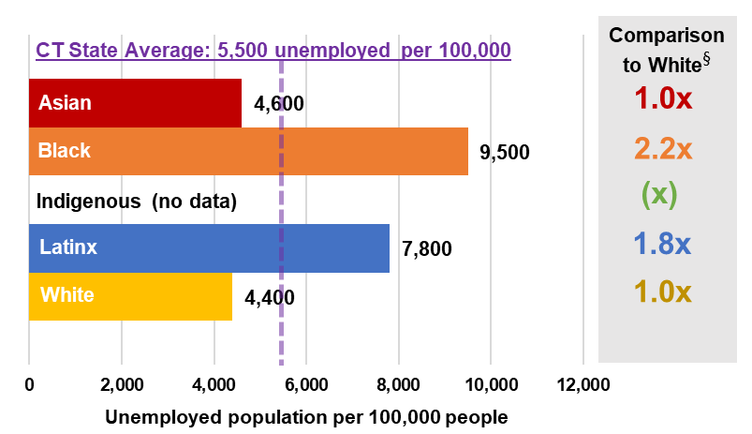
CONNECTICUT
Incarceration
Average Income
COVID-19 Cases*
Unemployment
These values highlight the disparities between BIPOC (Black populations, Indigenous populations, and populations of color) and white populations. Today in Connecticut, Black persons have a COVID-19 positive rate 2.5 times that of white persons.
§

Slide 5
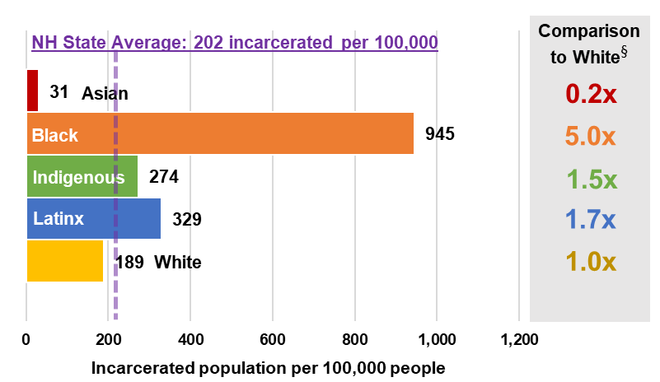
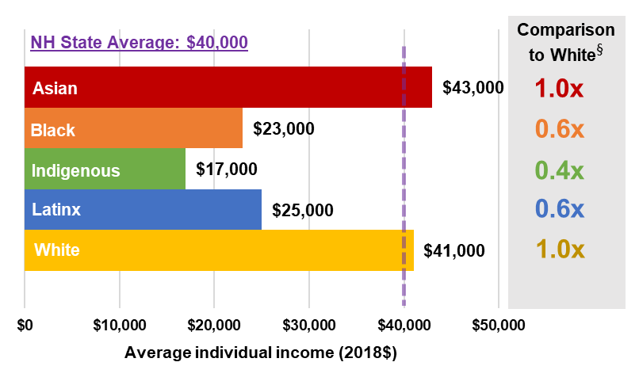
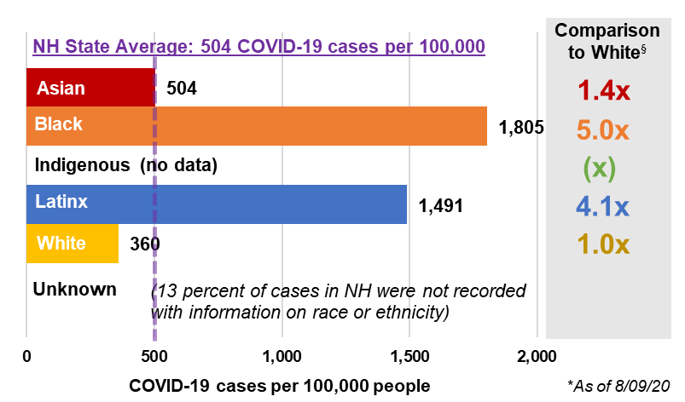
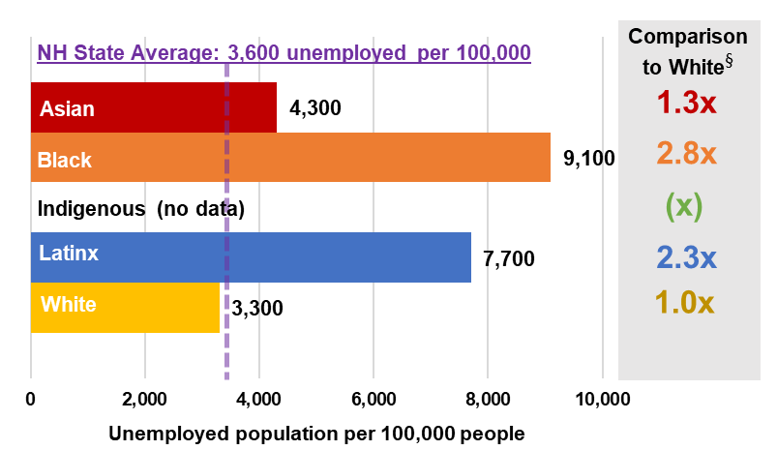
NEW HAMPSHIRE
Incarceration
Average Income
COVID-19 Cases*
Unemployment
These values highlight the disparities between BIPOC (Black populations, Indigenous populations, and populations of color) and white populations. Today in New Hampshire, Black persons have a COVID-19 positive rate 5.0 times that of white persons.
§

Slide 6
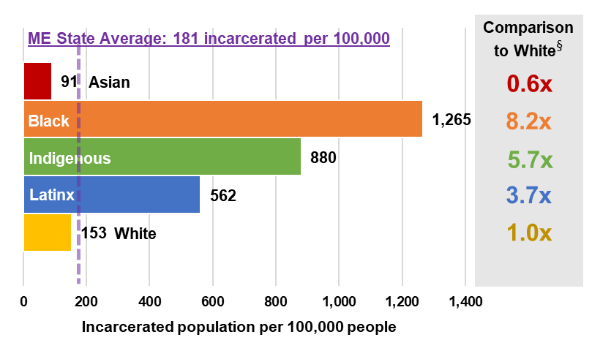
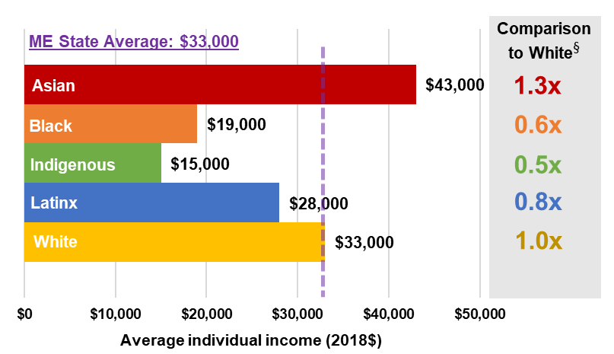
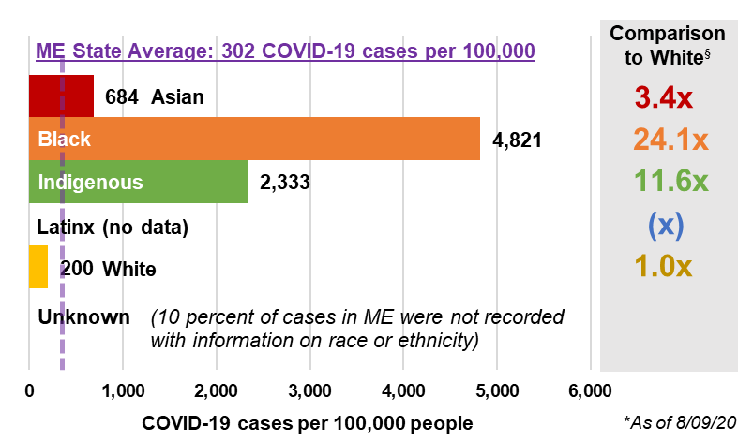
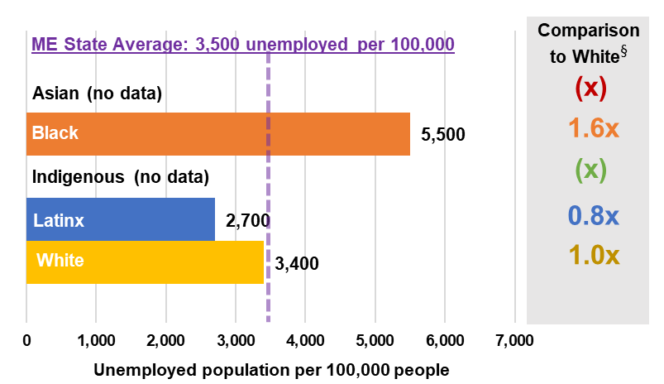
MAINE
Incarceration
Average Income
COVID-19 Cases*
Unemployment
These values highlight the disparities between BIPOC (Black populations, Indigenous populations, and populations of color) and white populations. Today in Maine, Black persons have a COVID-19 positive rate 24.1 times that of white persons.
§

Slide 7
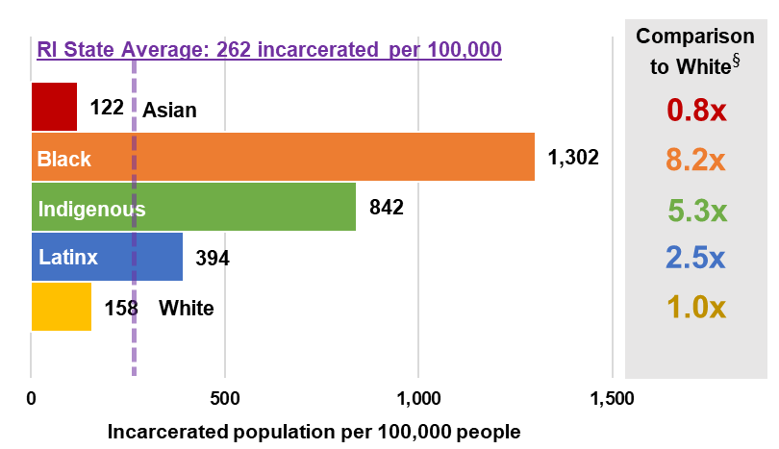
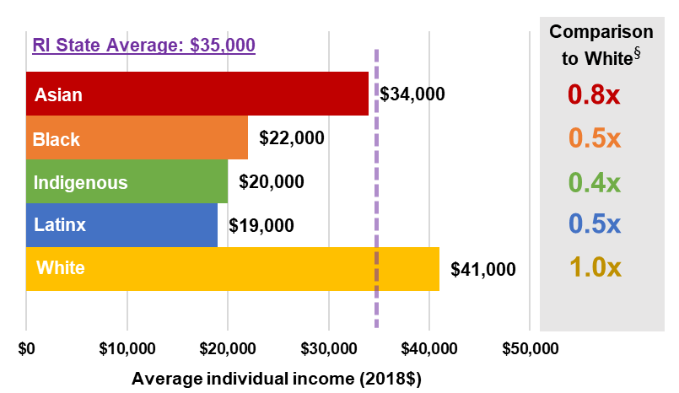
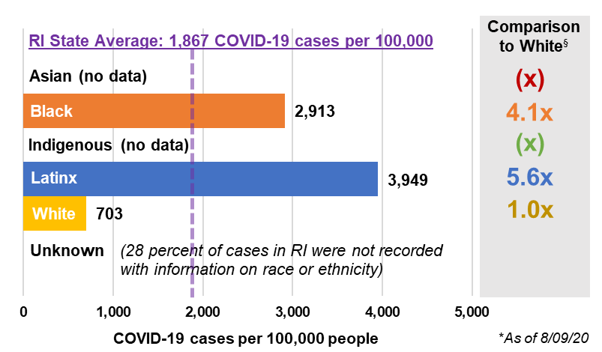
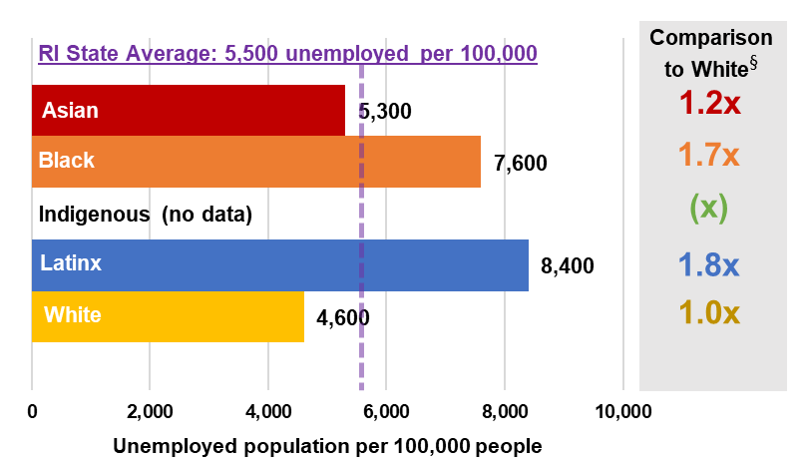
RHODE ISLAND
Incarceration
Average Income
COVID-19 Cases*
Unemployment
These values highlight the disparities between BIPOC (Black populations, Indigenous populations, and populations of color) and white populations. Today in Rhode Island, Black persons have a COVID-19 positive rate 4.1 times that of white persons.
§

Slide 8
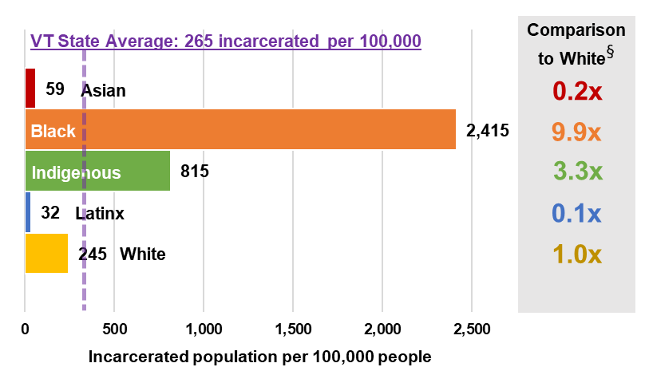
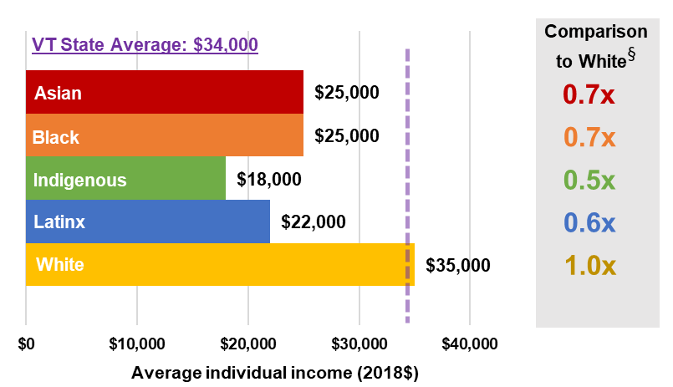
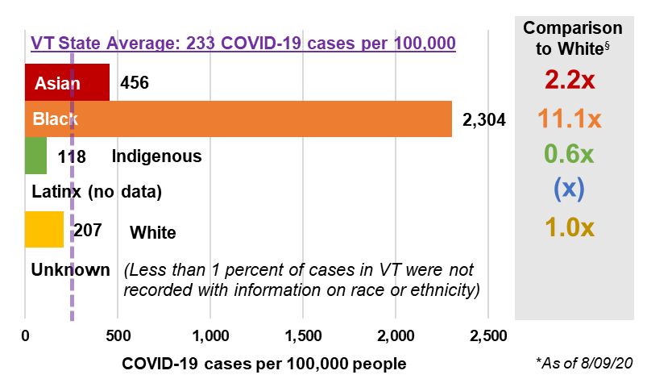
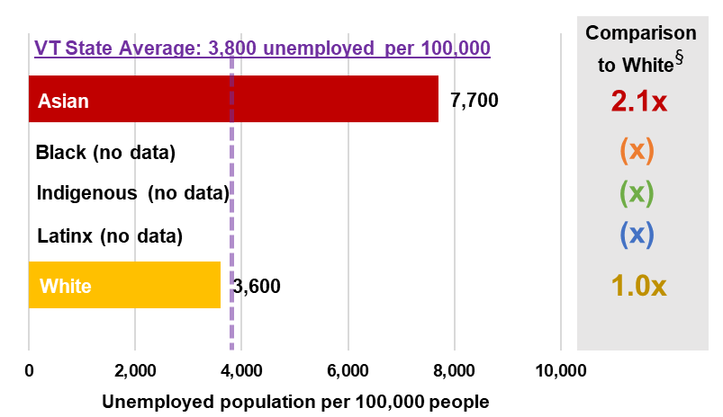
VERMONT
Incarceration
Average Income
COVID-19 Cases*
Unemployment
These values highlight the disparities between BIPOC (Black populations, Indigenous populations, and populations of color) and white populations. Today in Vermont, Black persons have a COVID-19 positive rate 11.1 times that of white persons.
§
§

Slide 9
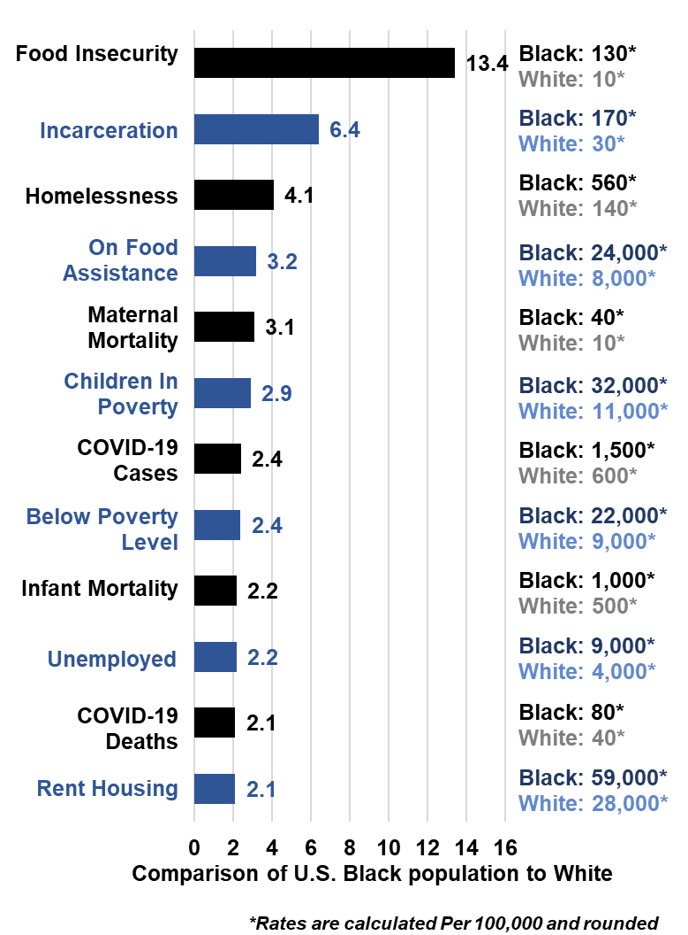
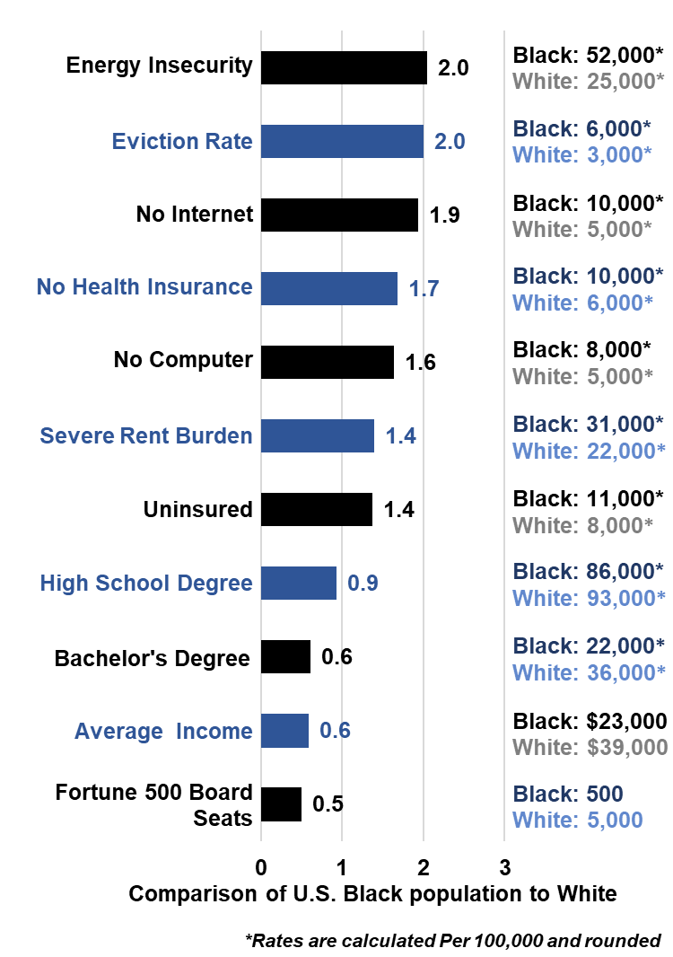
UNITED STATES RACIAL DISPARITIES
COVID-19 cases and death rates as of 08/09/2020

Slide 10
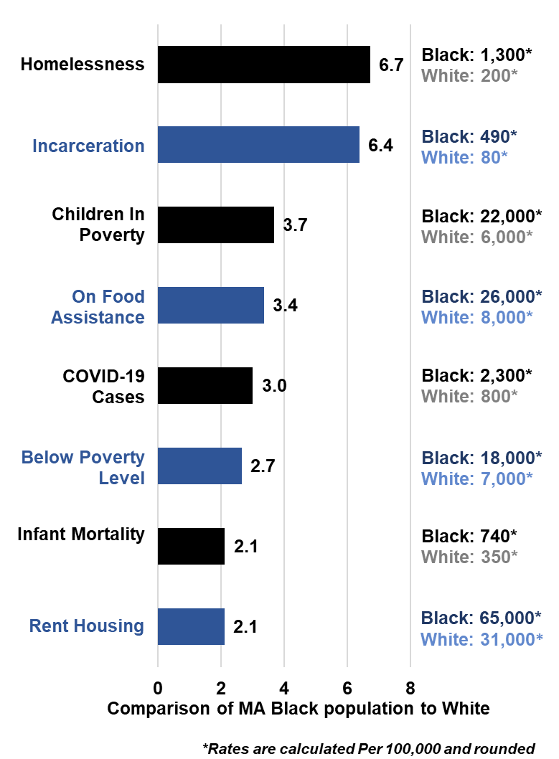
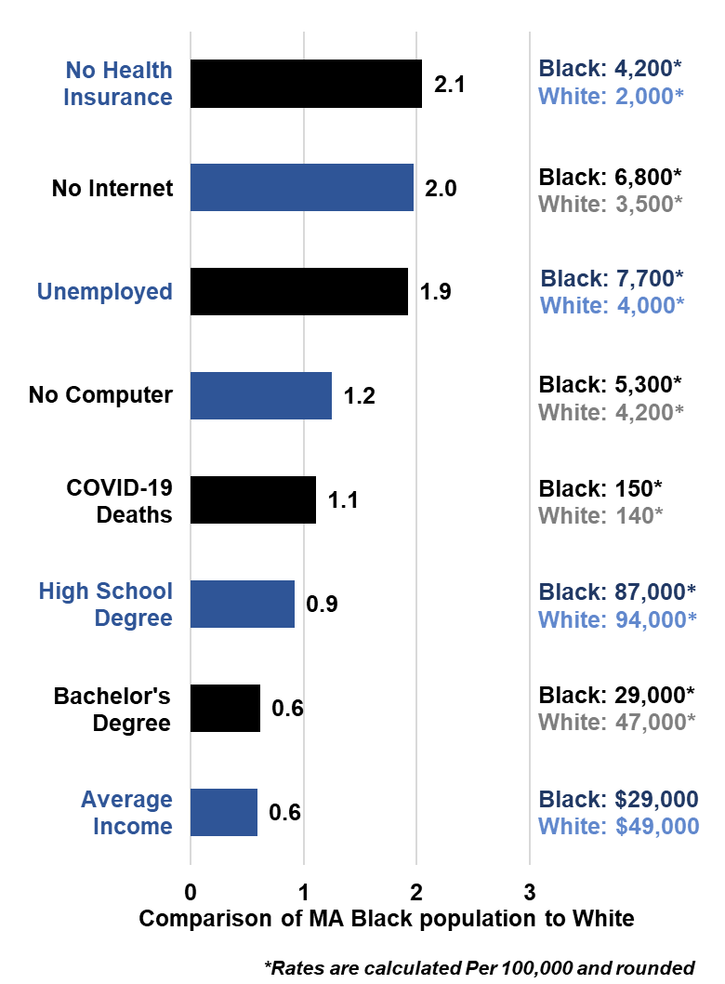
MASSACHUSETTS RACIAL DISPARITIES
COVID-19 cases and death rates as of 08/09/2020

Slide 11
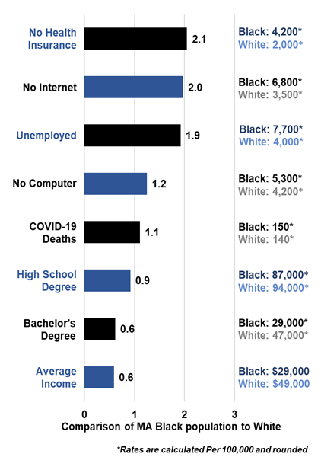
MASSACHUSETTS
COVID-19 cases and death rates as of 08/09/2020

Slide 12
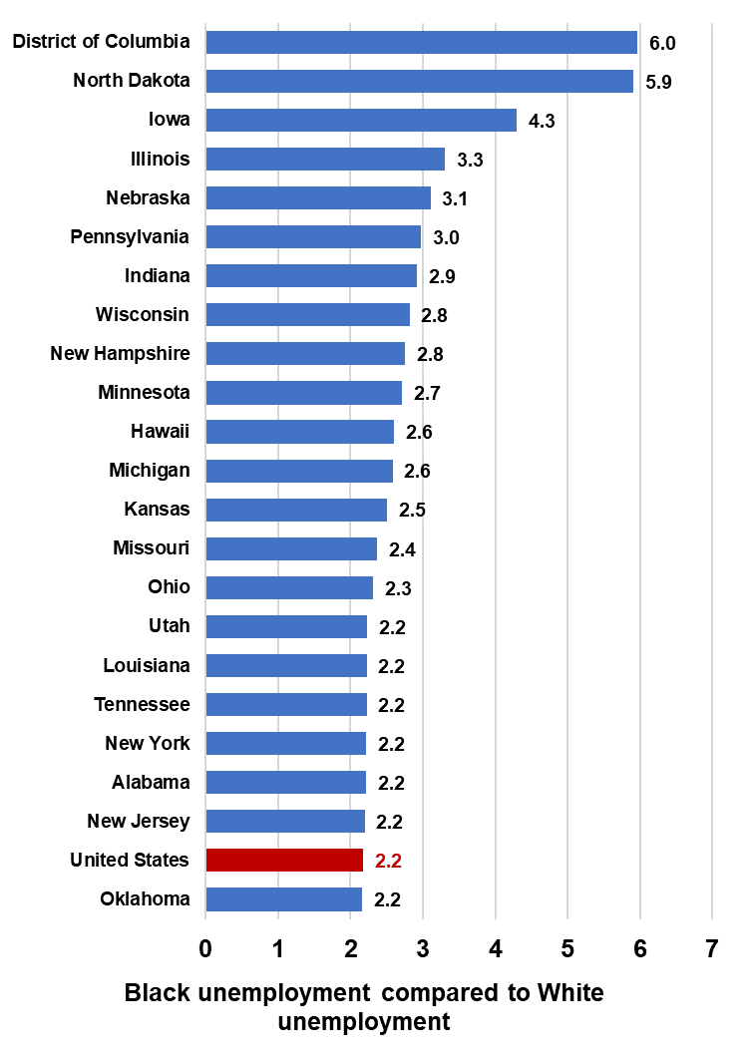
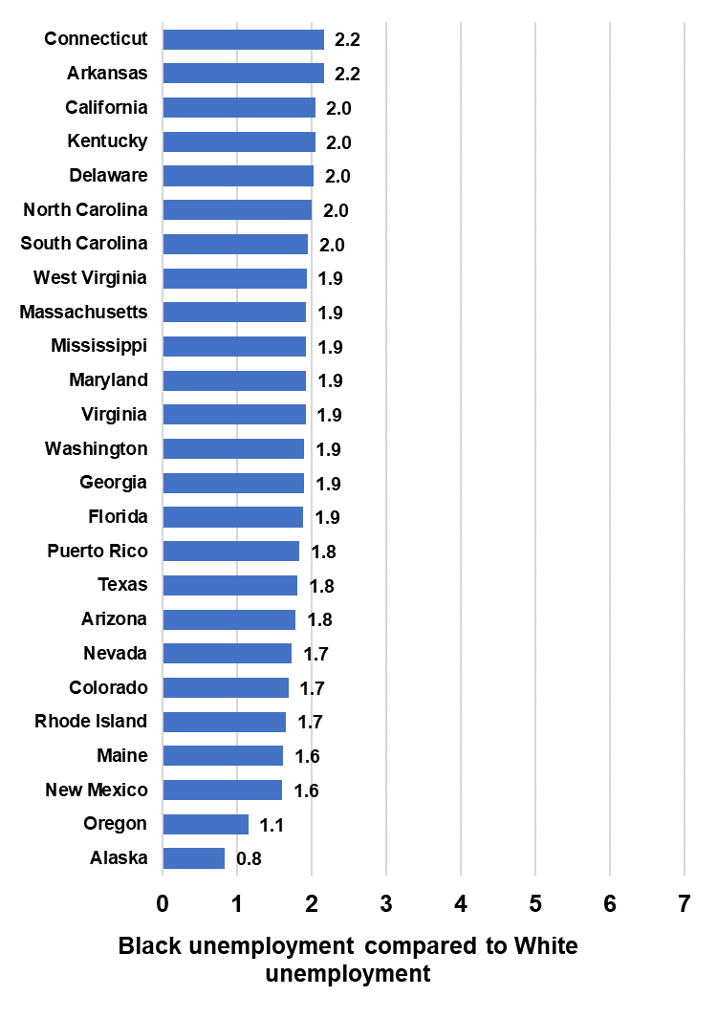
BLACK UNEMPLOYMENT COMPARED TO WHITE BY STATE

